Slide 1
Discrete Mathematics: Lecture 29 Part IV. Graph Theory Rooted Tree, Tree Traversals, DFS, BFS
Xuming He
Associate Professor
School of Information Science and Technology
ShanghaiTech University
Spring Semester, 2024
Notes by Prof. Liangfeng Zhang

Slide 2
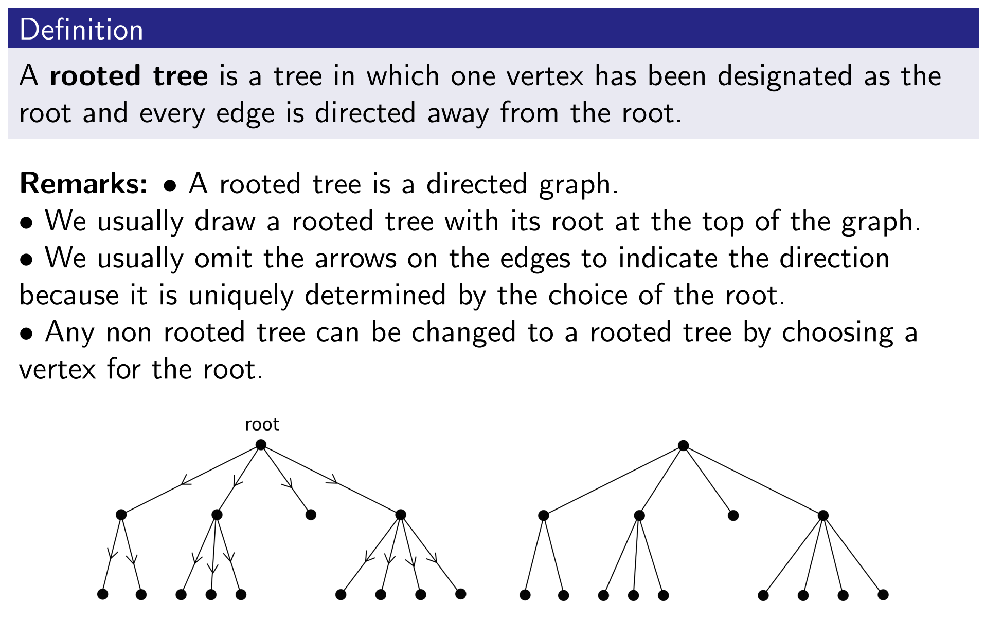
Review: Rooted Tree

Slide 3
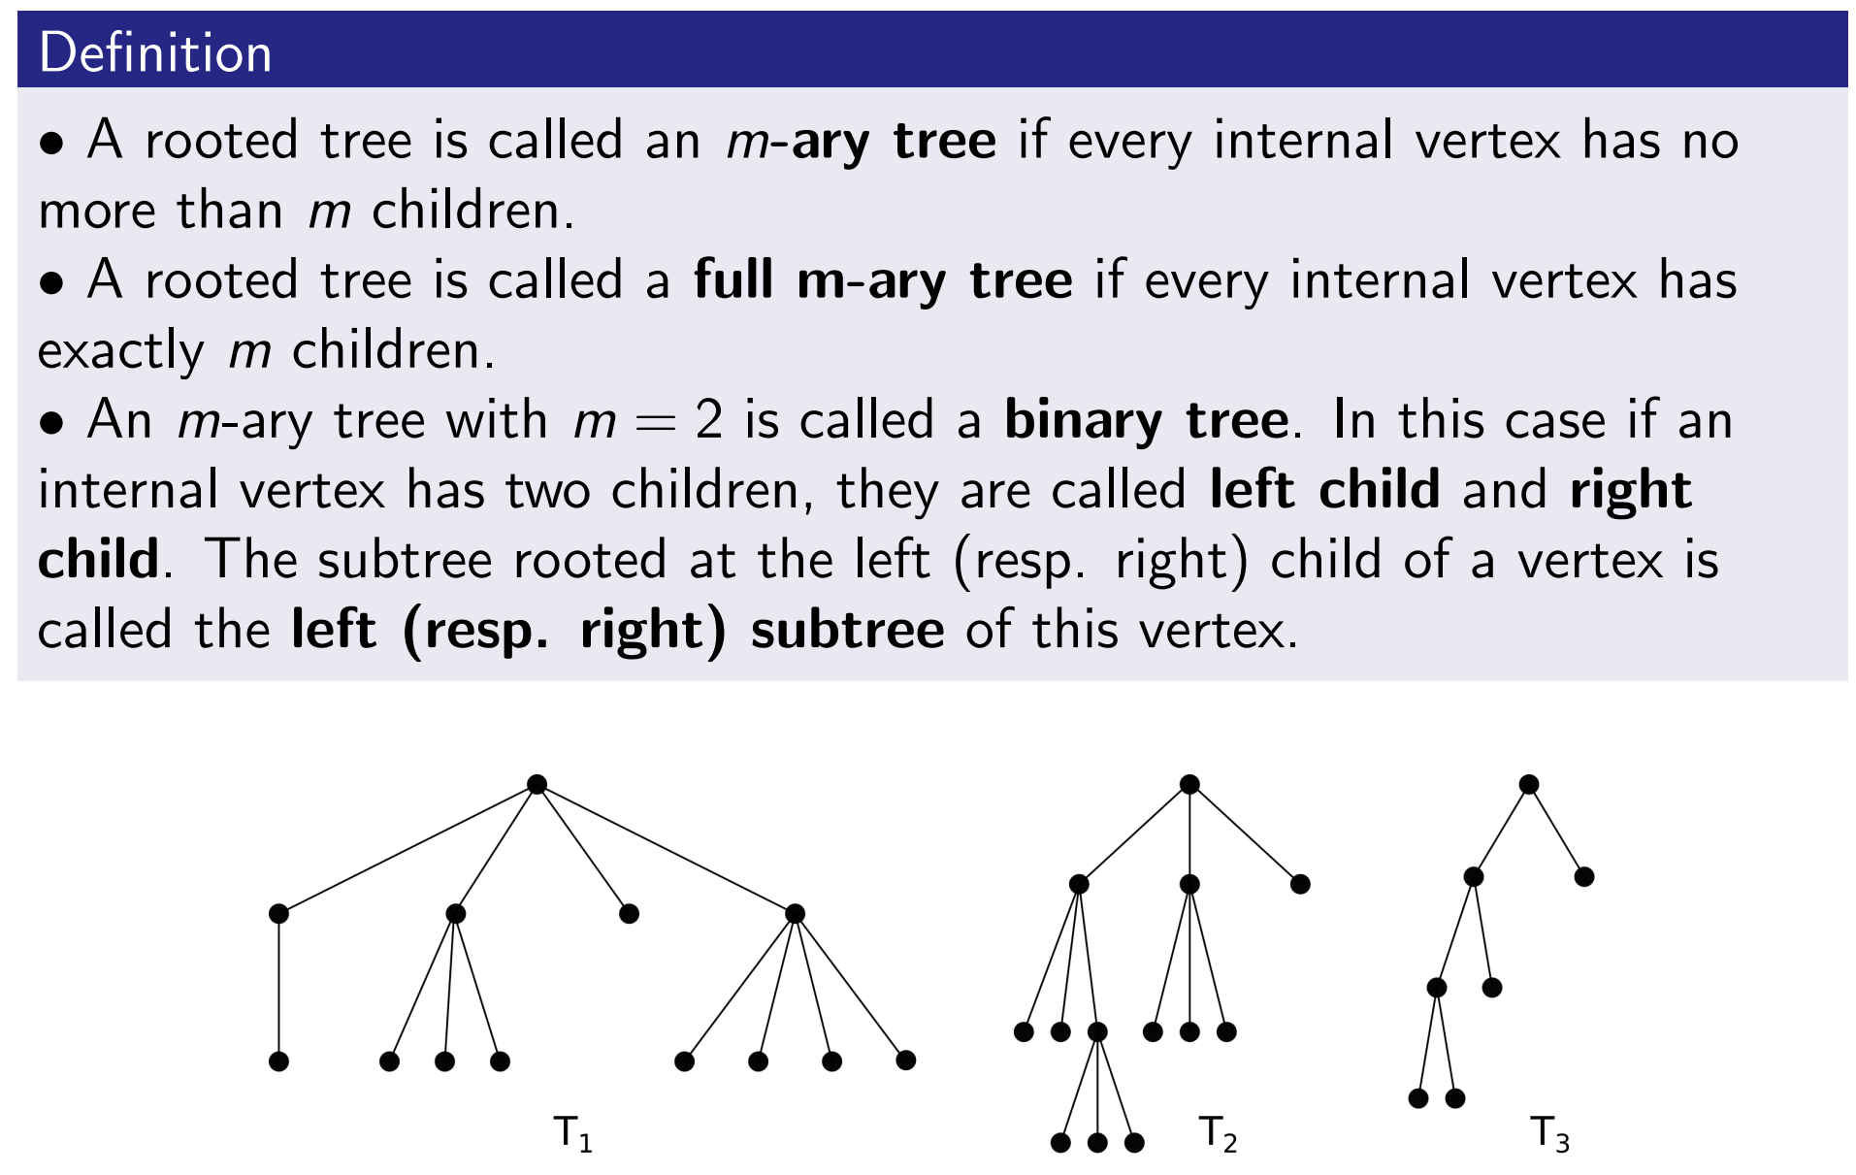
Review: Rooted Tree

Slide 4
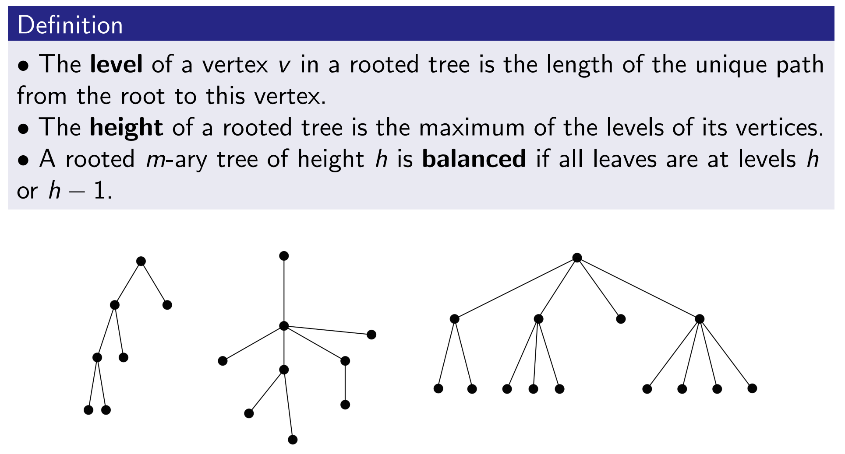
Review: Balanced m-ary Tree

Slide 5
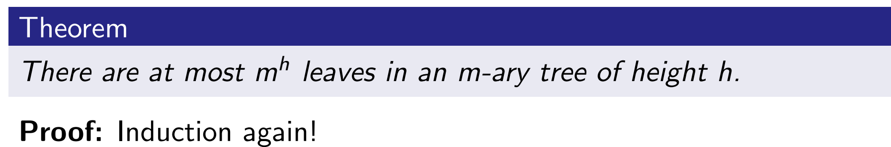
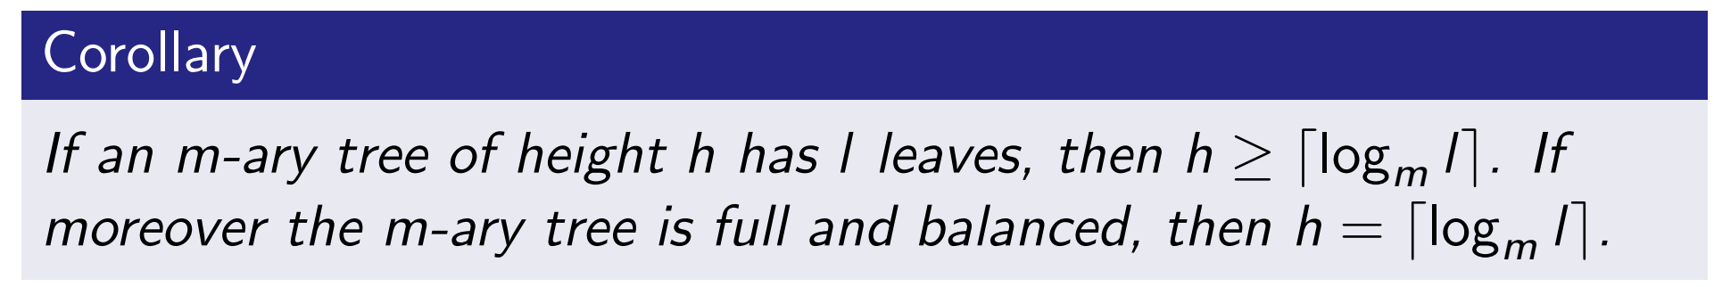
Balanced m-ary Tree

Slide 6
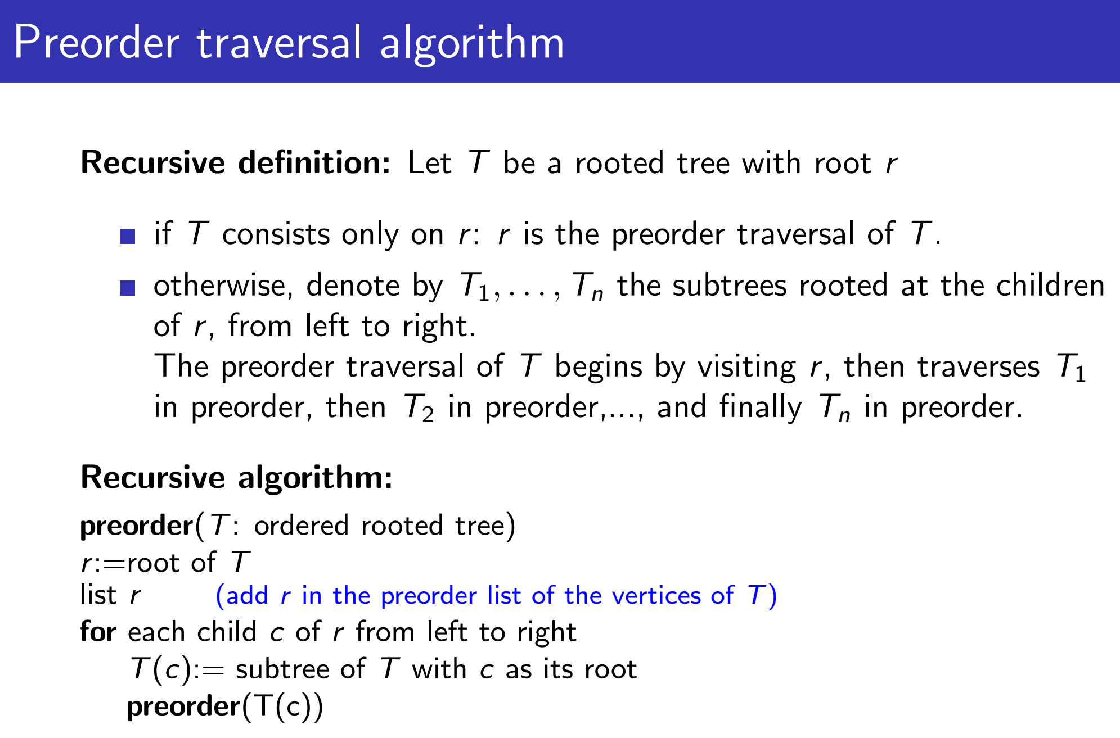
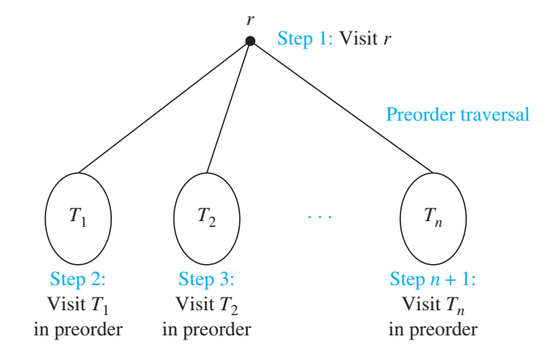
Tree Traversals

Slide 7
Tree Traversals

Slide 8
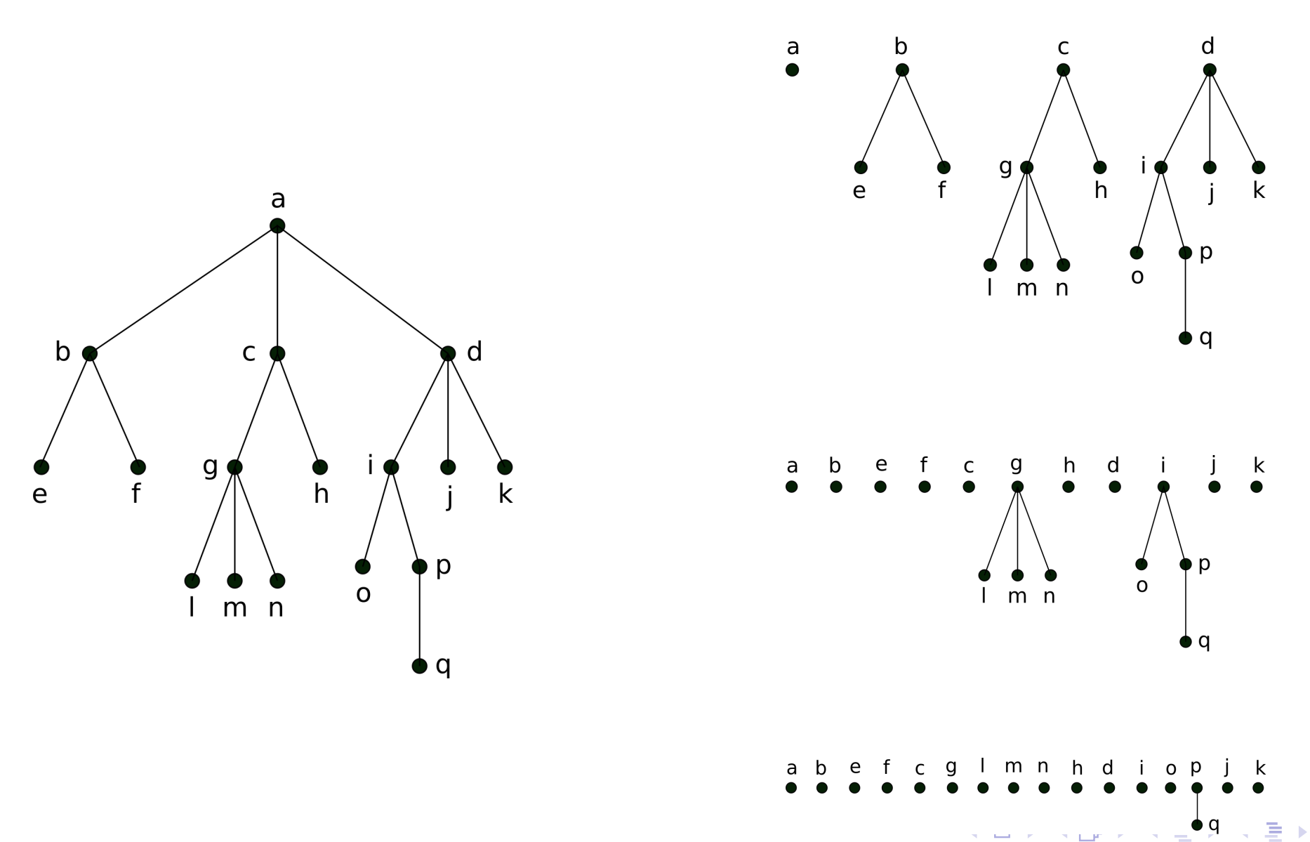
Tree Traversals

Slide 9
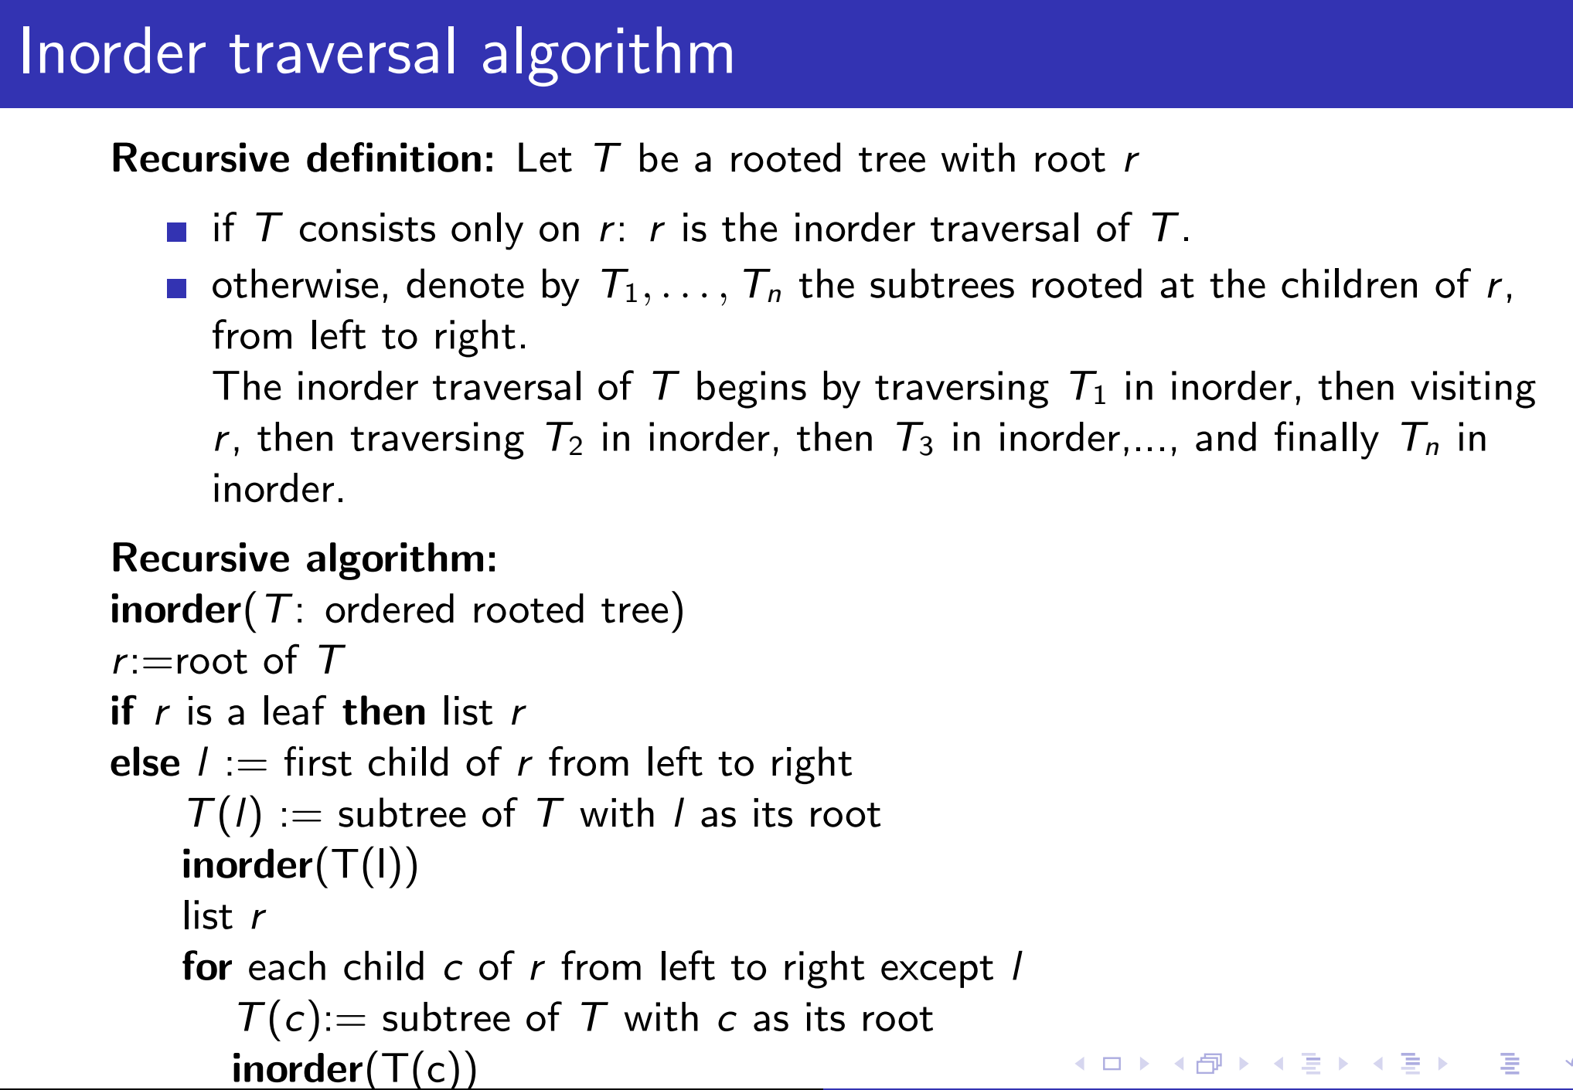
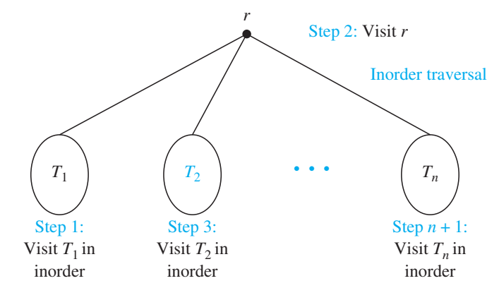
Tree Traversals

Slide 10
Tree Traversals

Slide 11
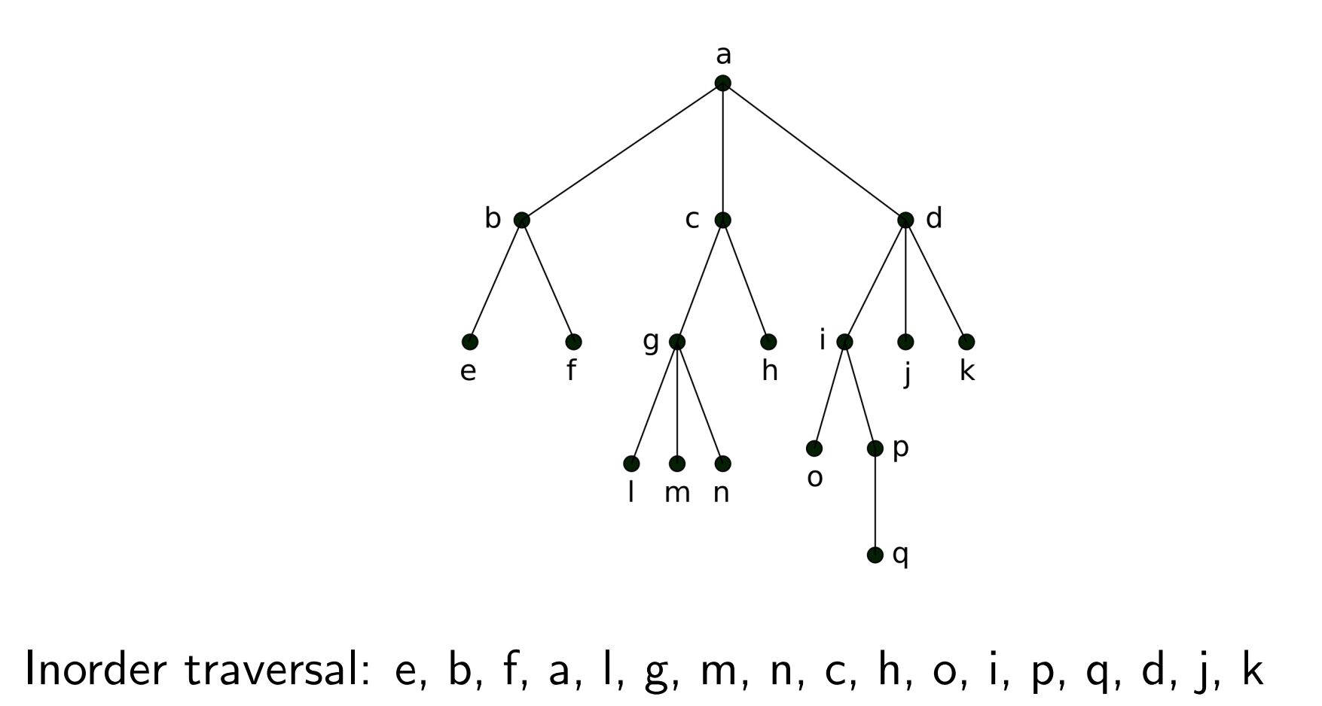
Tree Traversals

Slide 12
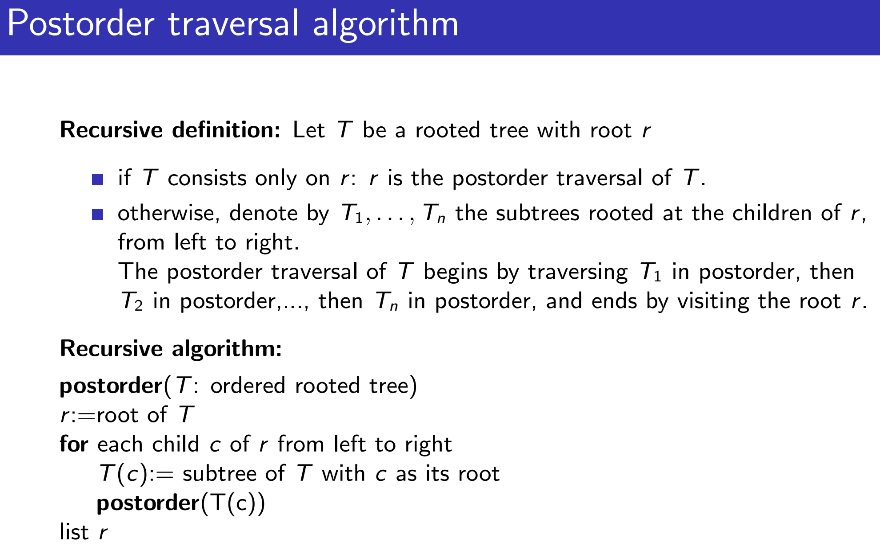
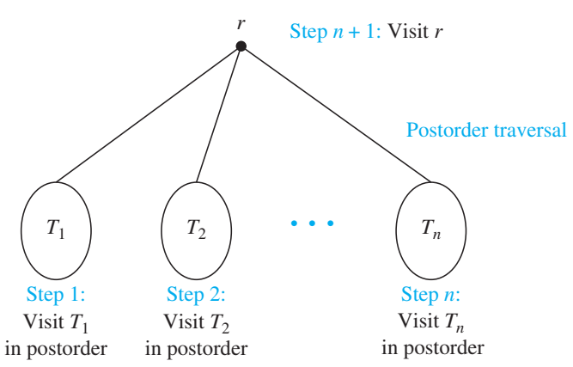
Tree Traversals

Slide 13
Tree Traversals

Slide 14
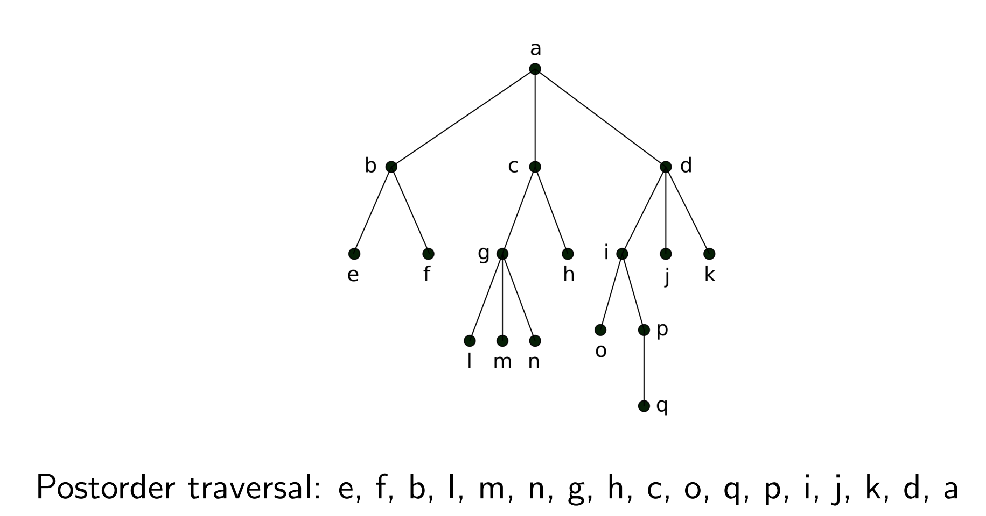
Tree Traversals

Slide 15
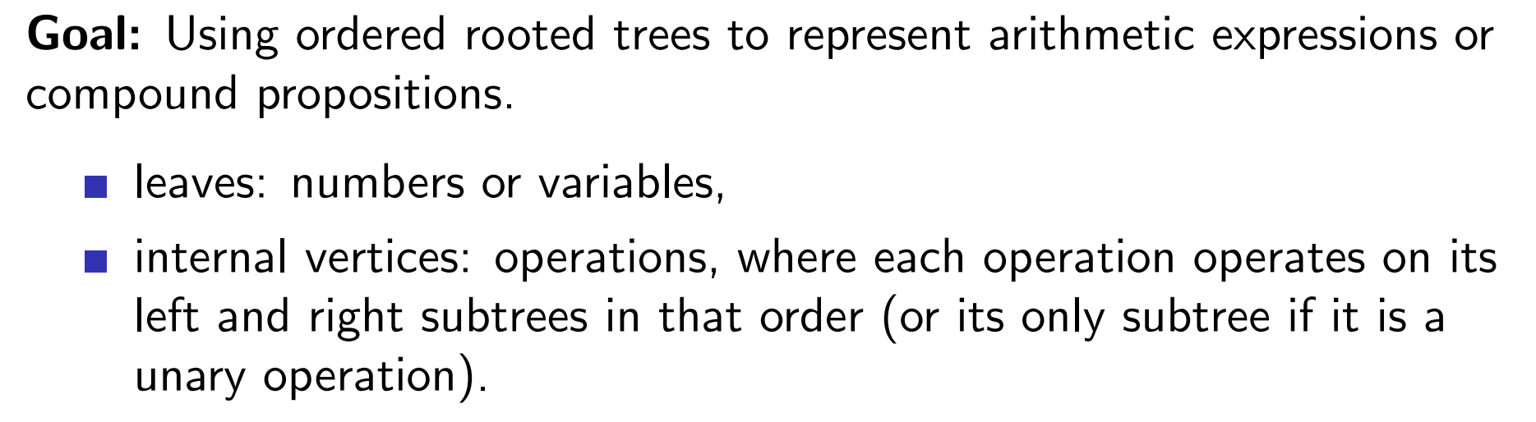
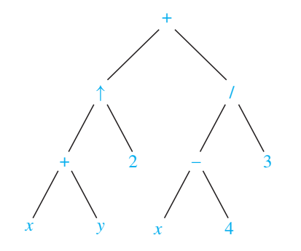
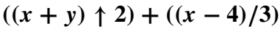
Infix, Prefix, Postfix Notation

Slide 16
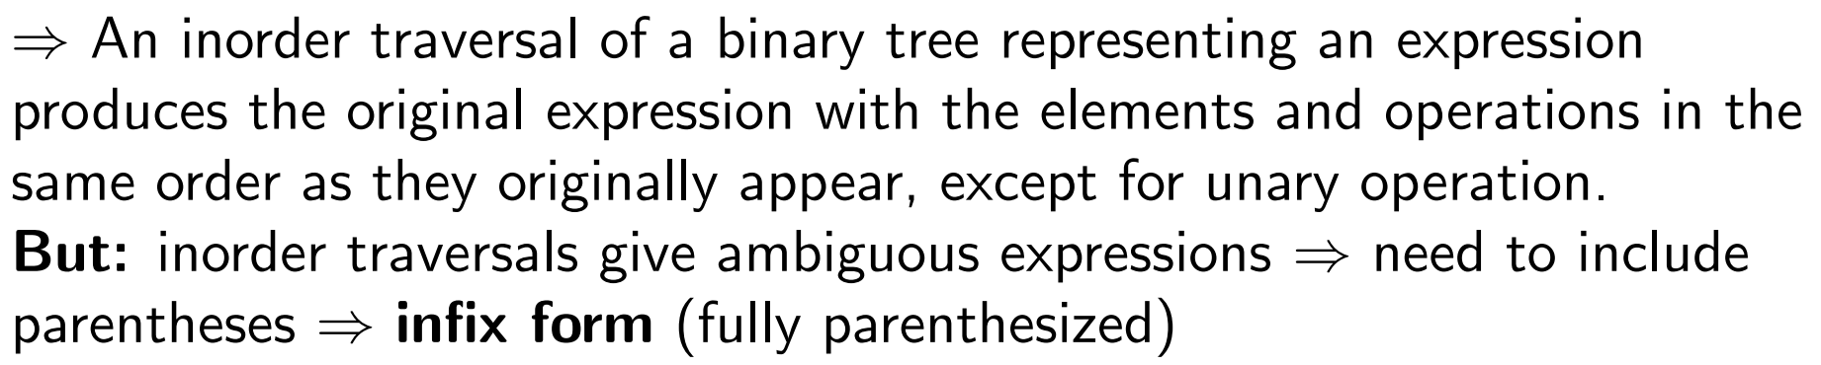
Infix, Prefix, Postfix Notation

Slide 17
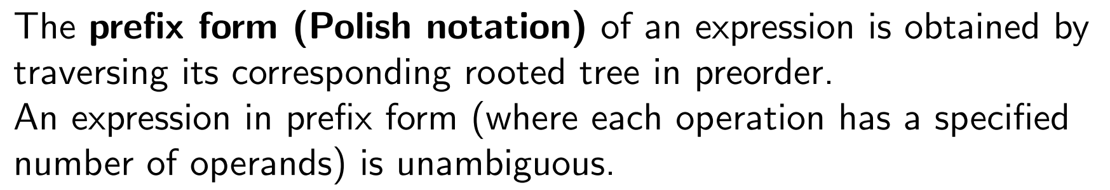
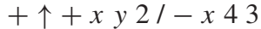
Infix, Prefix, Postfix Notation
Evaluate an expression in prefix form by working from right to left.
When we encounter an operator, we perform the corresponding operation with the two operands immediately to the right of this operand.

Slide 18
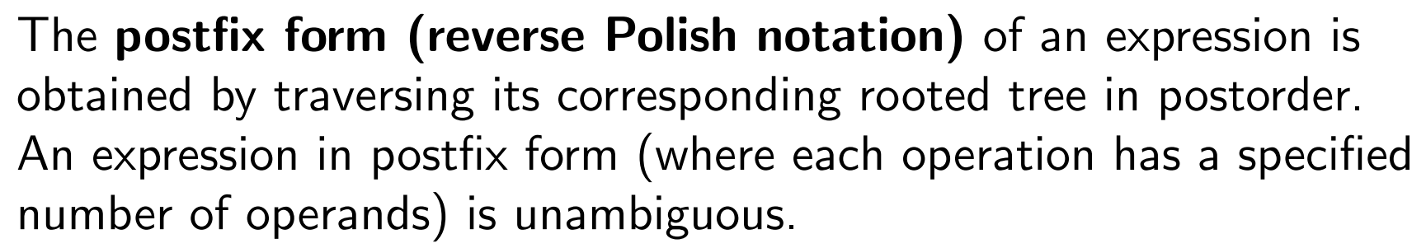
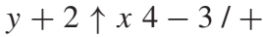
Infix, Prefix, Postfix Notation
Work from left to right, carrying out operations whenever an operator follows two operands.
After an operation is carried out, the result of this operation becomes a new operand.

Slide 19
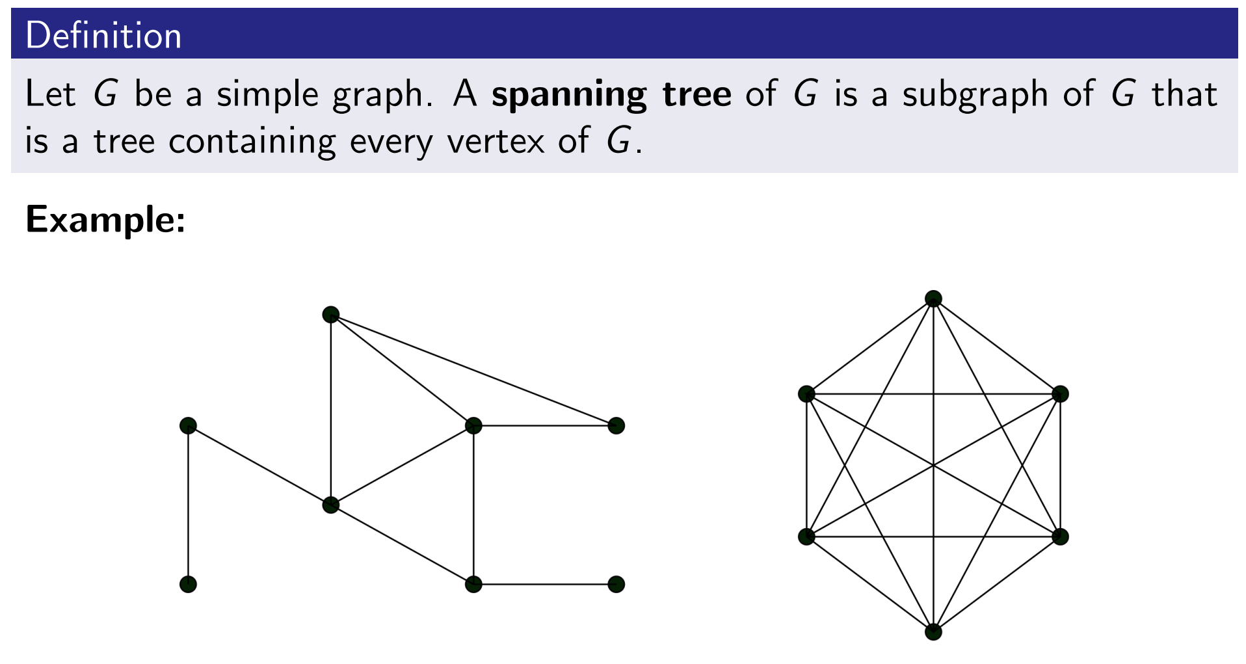
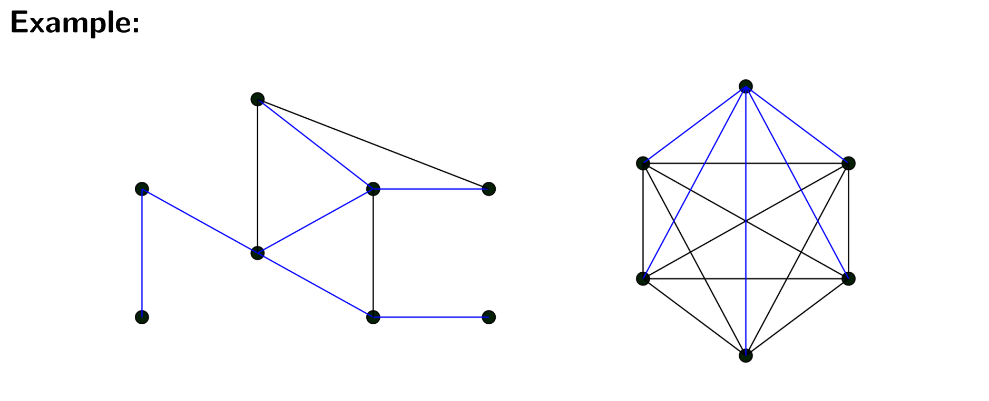
Spanning Trees

Slide 20
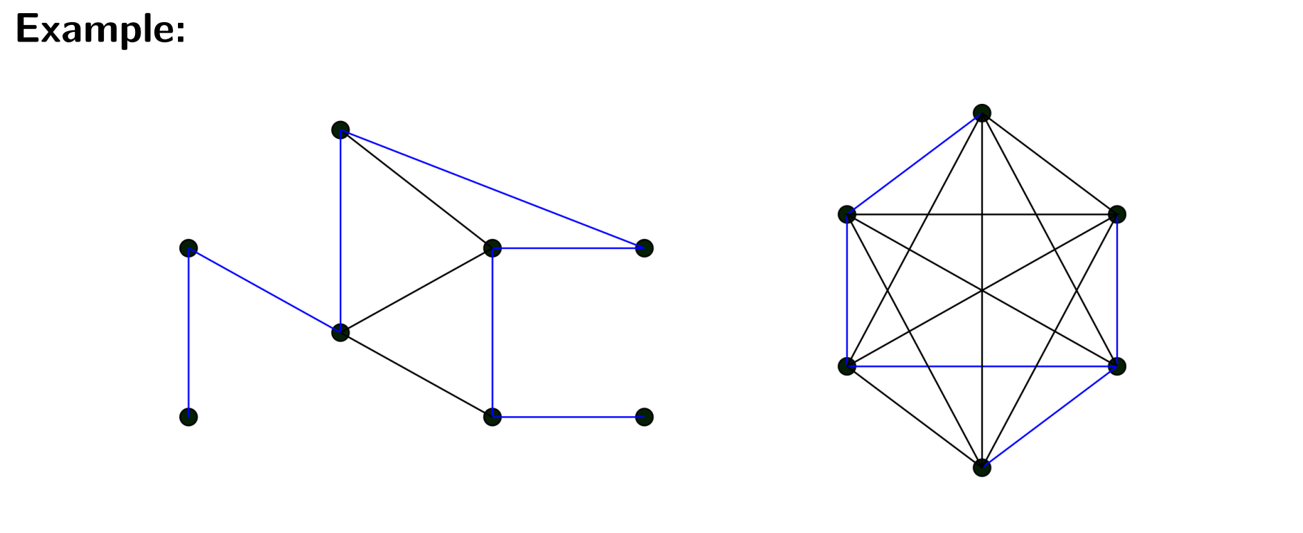
Spanning Trees

Slide 21
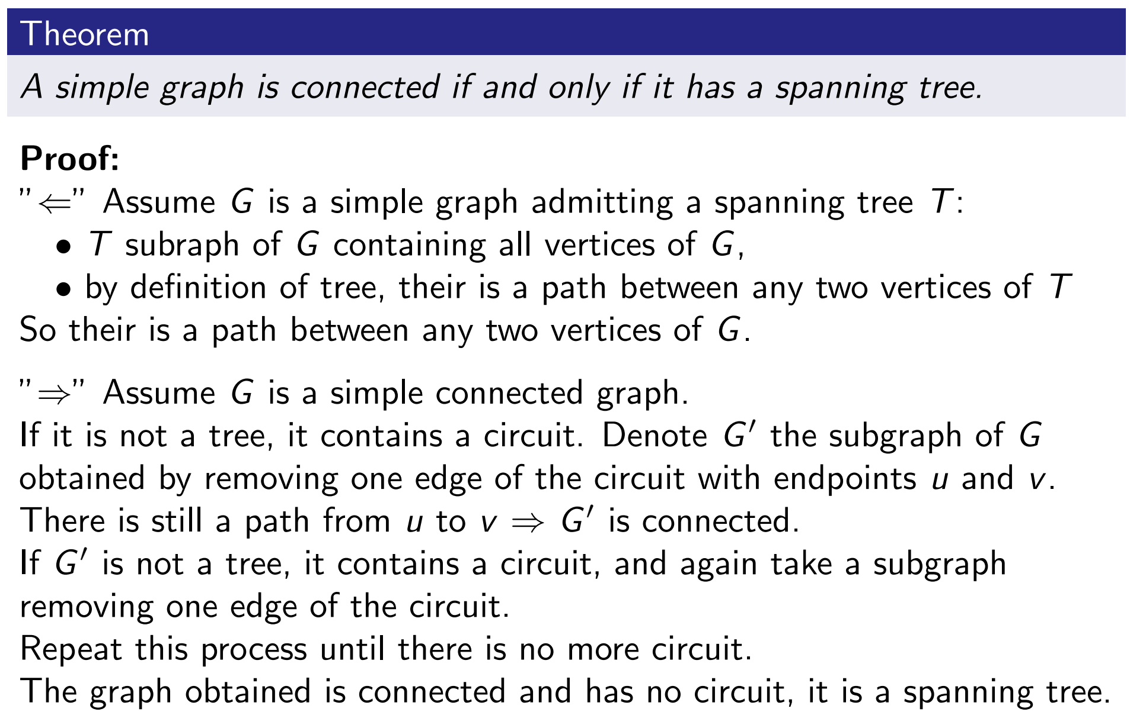
Spanning Trees

Slide 22
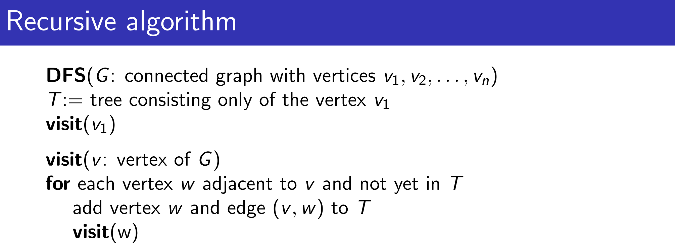
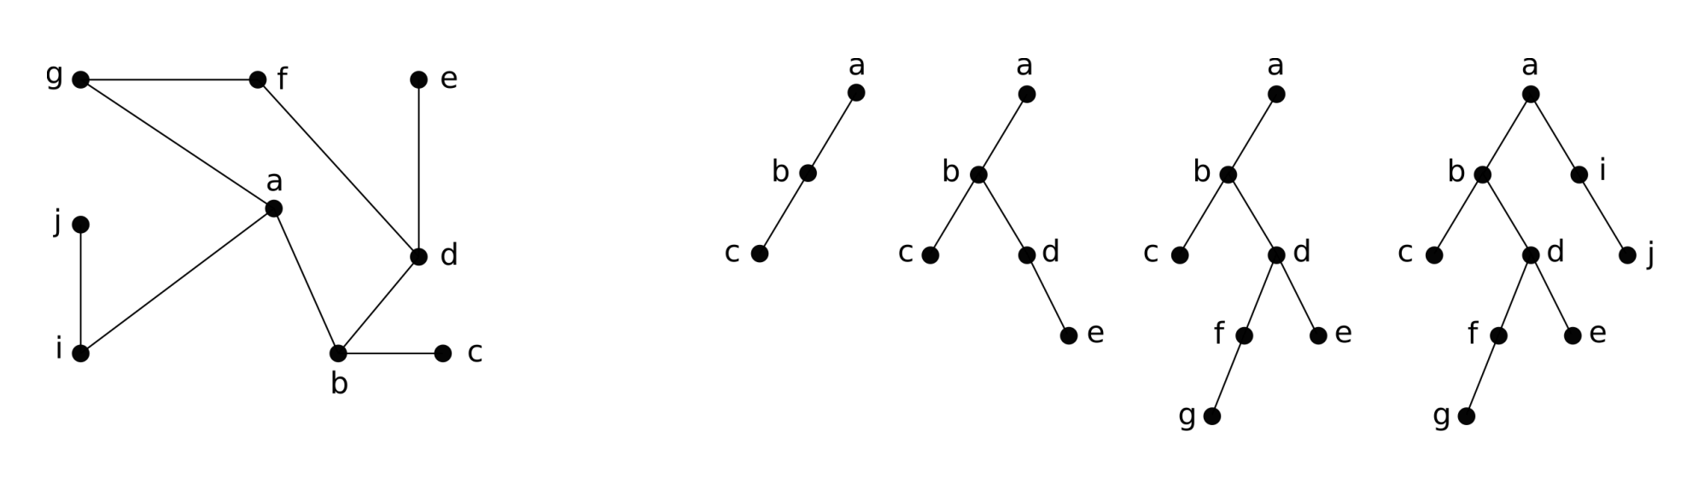
Depth-first Search

Slide 23
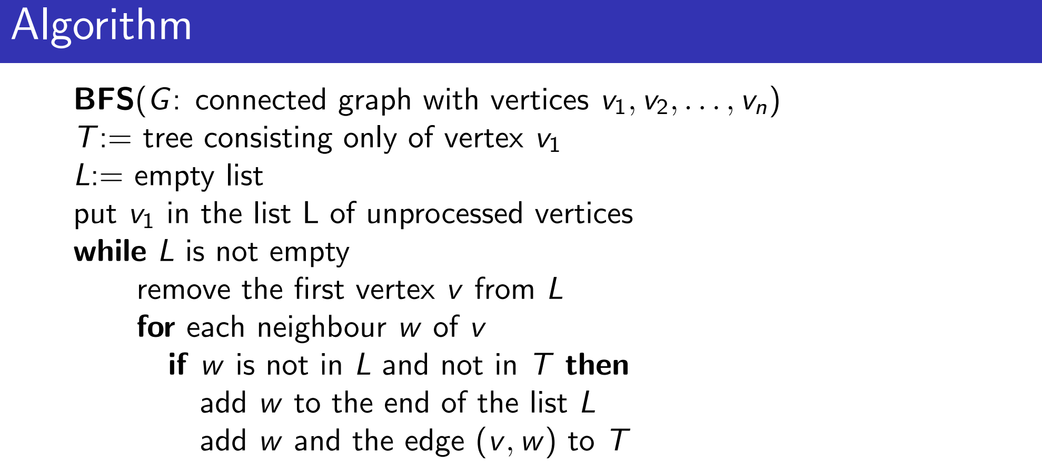
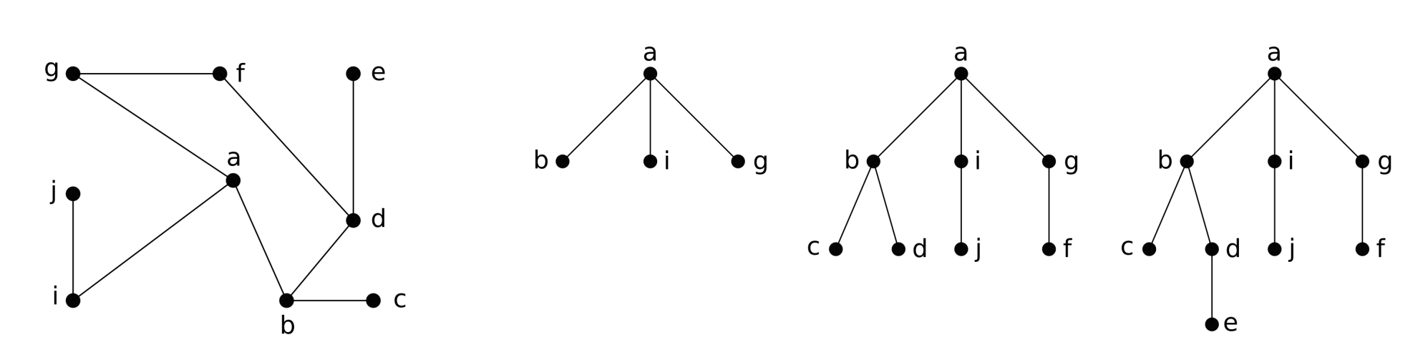
Breadth-first Search

Slide 24
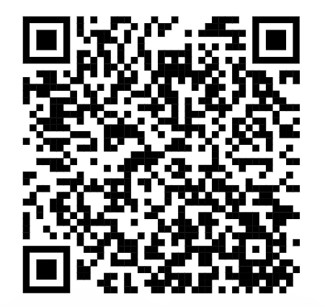
Course Evaluation
Please provide your feedback, which is valuable for us to improve the course

